Slide 1
Choice of Algorithms and Algorithm Dynamics : Part 2
BDK17-2 | Clustering
Shannon McWeeney, PhD | Department of Medical Informatics & Clinical Epidemiology
Oregon Health & Science University

Slide 2


Slide 3

Horia Varlan 2008 (https://www.flickr.com/photos/horiavarlan/4273102419/) [CC BY 2.0] via Flickr
Notes:
https://www.flickr.com/photos/horiavarlan/4273102419/

Slide 4
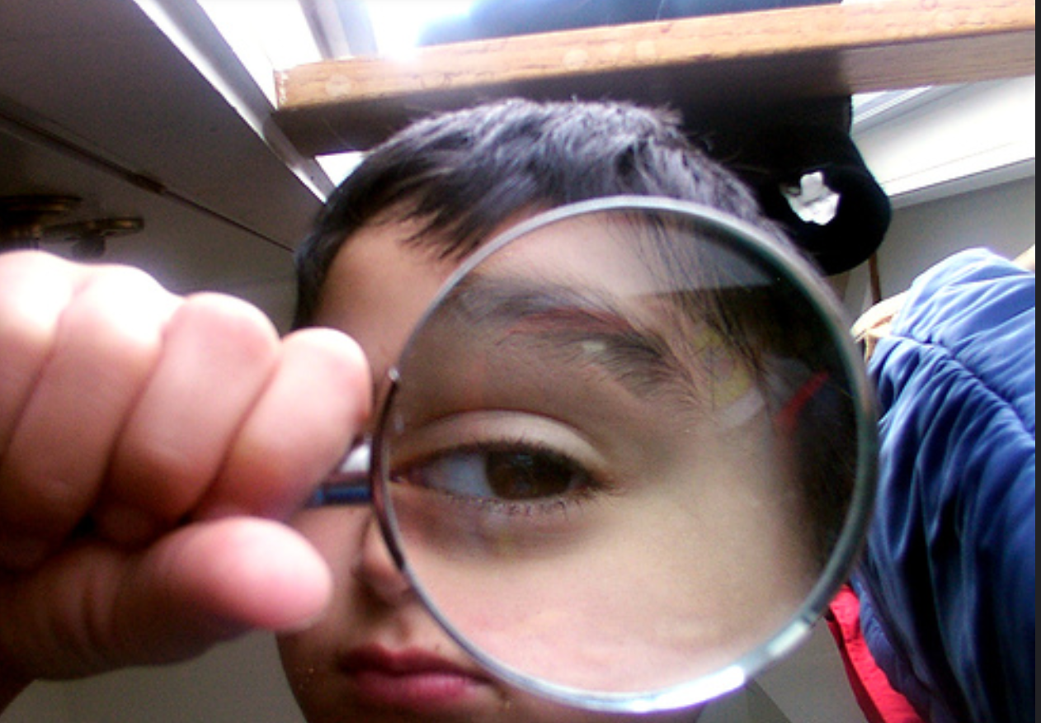
chrisbb@prodigy.net 2007 (https://www.flickr.com/photos/15577588@N00/1832787028) [CC BY 2.0] via Flickr
Notes:
https://www.flickr.com/photos/15577588@N00/1832787028

Slide 7
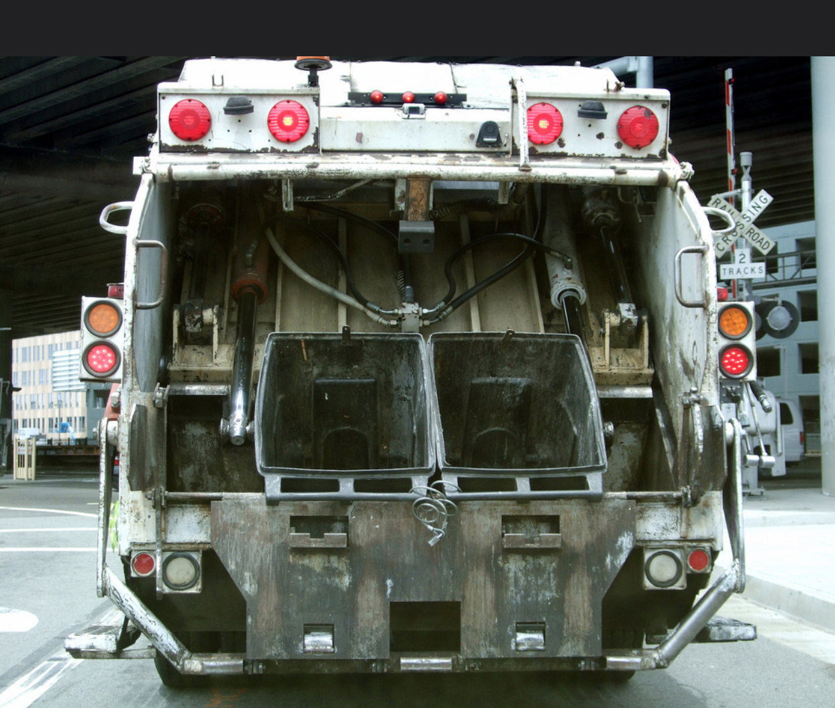
SMcGarnigle 2009 (https://www.flickr.com/photos/mcbarnicle/3642672929) [CC BY 2.0] via Flickr
Notes:
https://www.flickr.com/photos/mcbarnicle/3642672929

Slide 8
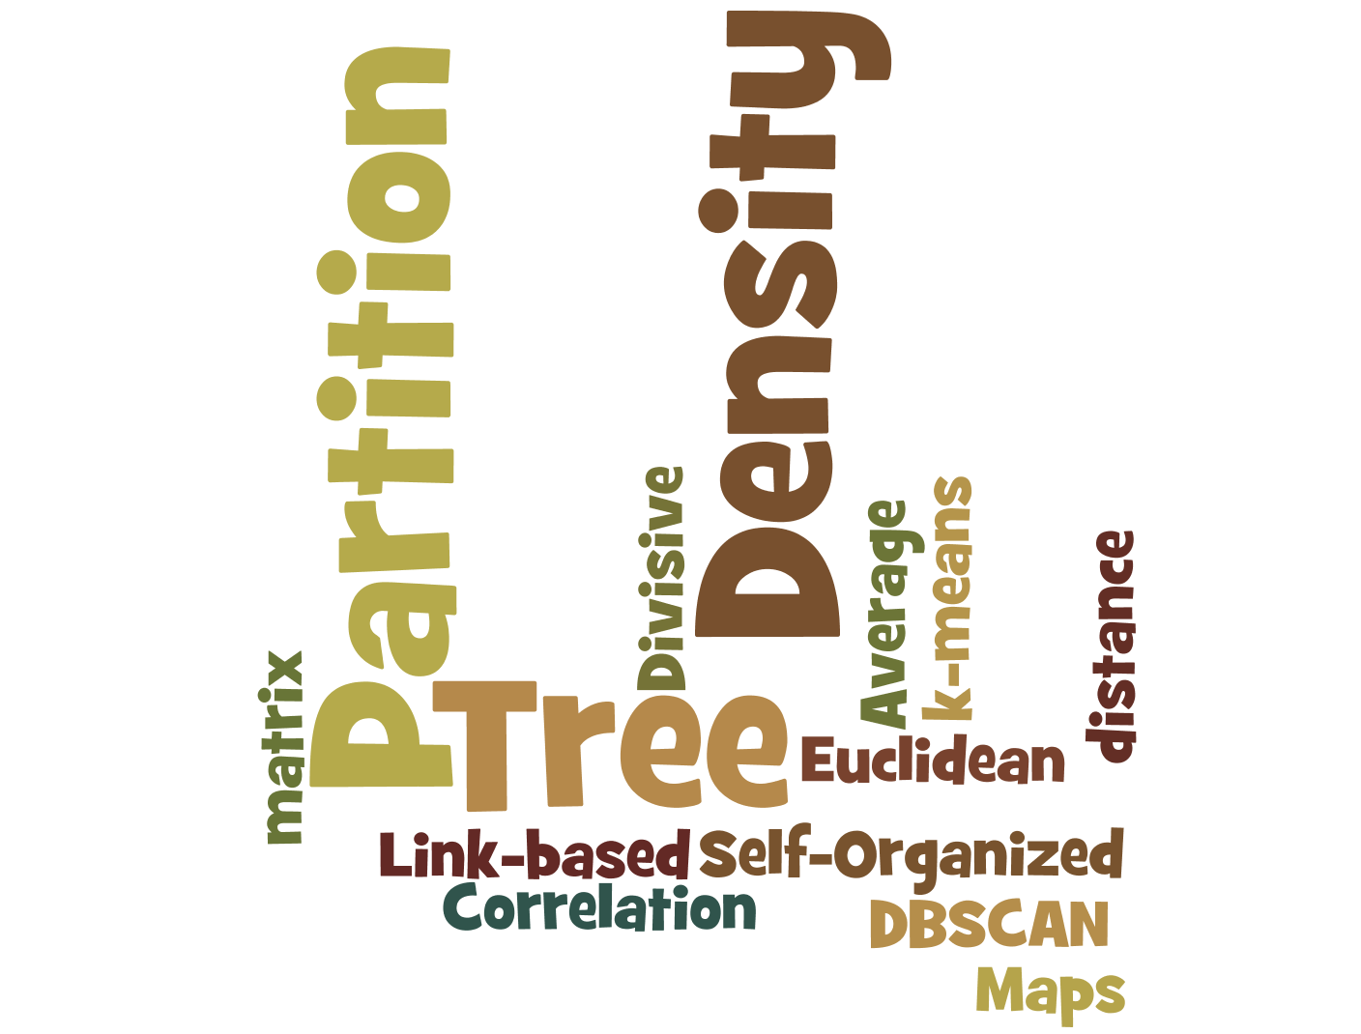

Slide 11
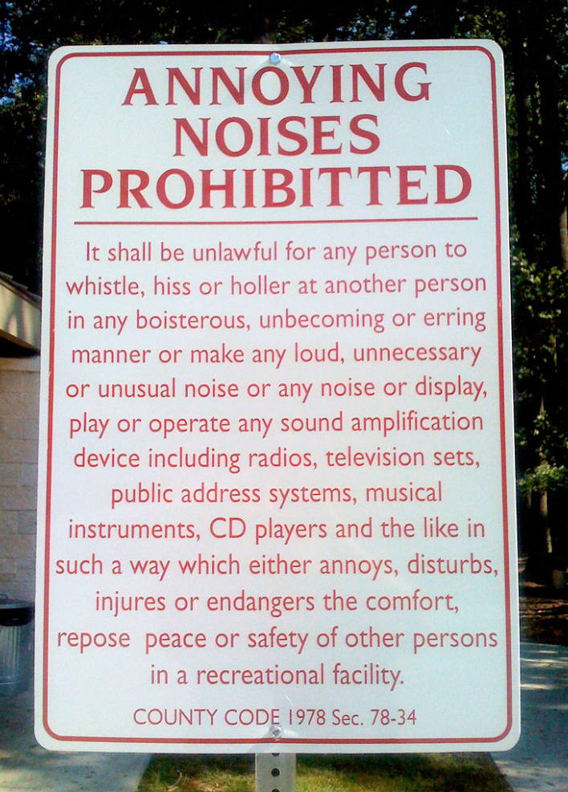
Patrick Fitzgerald 2008 ( https://www.flickr.com/photos/barelyfitz/2898020303/ )[CC BY 2.0], via Flickr
Notes:
https://www.flickr.com/photos/barelyfitz/2898020303/

